Slide 1
Decoding Mutual Fund Performance: Dynamic Return Patterns via Deep Learning
Norman Guo
Georgia State University
Notes:
Good Morning Everyone! First of all, thank you so much for being here given that it’s only 8:30 in the morning. And thank you so much to Professor Wang for organizing the session. It’s pleasure to be able to talk about this paper. I am currently a fourth-year PhD student at GSU. One of my research interest is to uncover innovation in financial services driven by new technologies or new investment vehicle like ETFs. This is one of the related projects I am working on and actually is also my second-year paper.
I came up with this idea when I read WSJ which mentioned that some Mutual funds hold ETFs.

Slide 2
Motivation
Mutual fund performance is not persistent overtime
Mutual fund managers have limited skill or no skill
Mutual fund managers have time-varying skill
Ferson and Schadt (1996), Christopherson, Ferson, and Glassman (1998), Moskowitz (2000)
Kacperczyk, Nieuwerburgh, and Veldkamp (2014)
“stock picking and market timing are tasks, rather than distinct and permanent talents. Skilled managers can successfully perform these tasks, but how much of each they choose to do depends on the market environment”

Slide 3
Motivation
Mutual fund managers may adopt different and dynamic strategies in different economic states
Learn from historical performance and macro conditions
Investment is a human decision

Slide 4
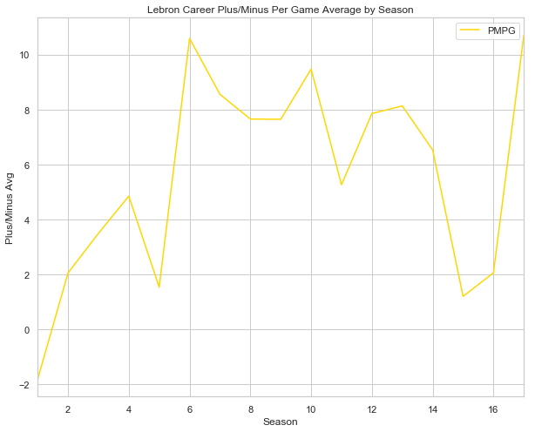
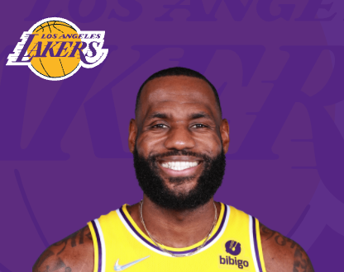
Performance of NBA Player
Season | Game Efficiency
Regular Season | 21.7
Playoff Season | 25.2
Time | Game Efficiency
First Quarter | 20.4
Last 3 Minutes | 28.3

Slide 5
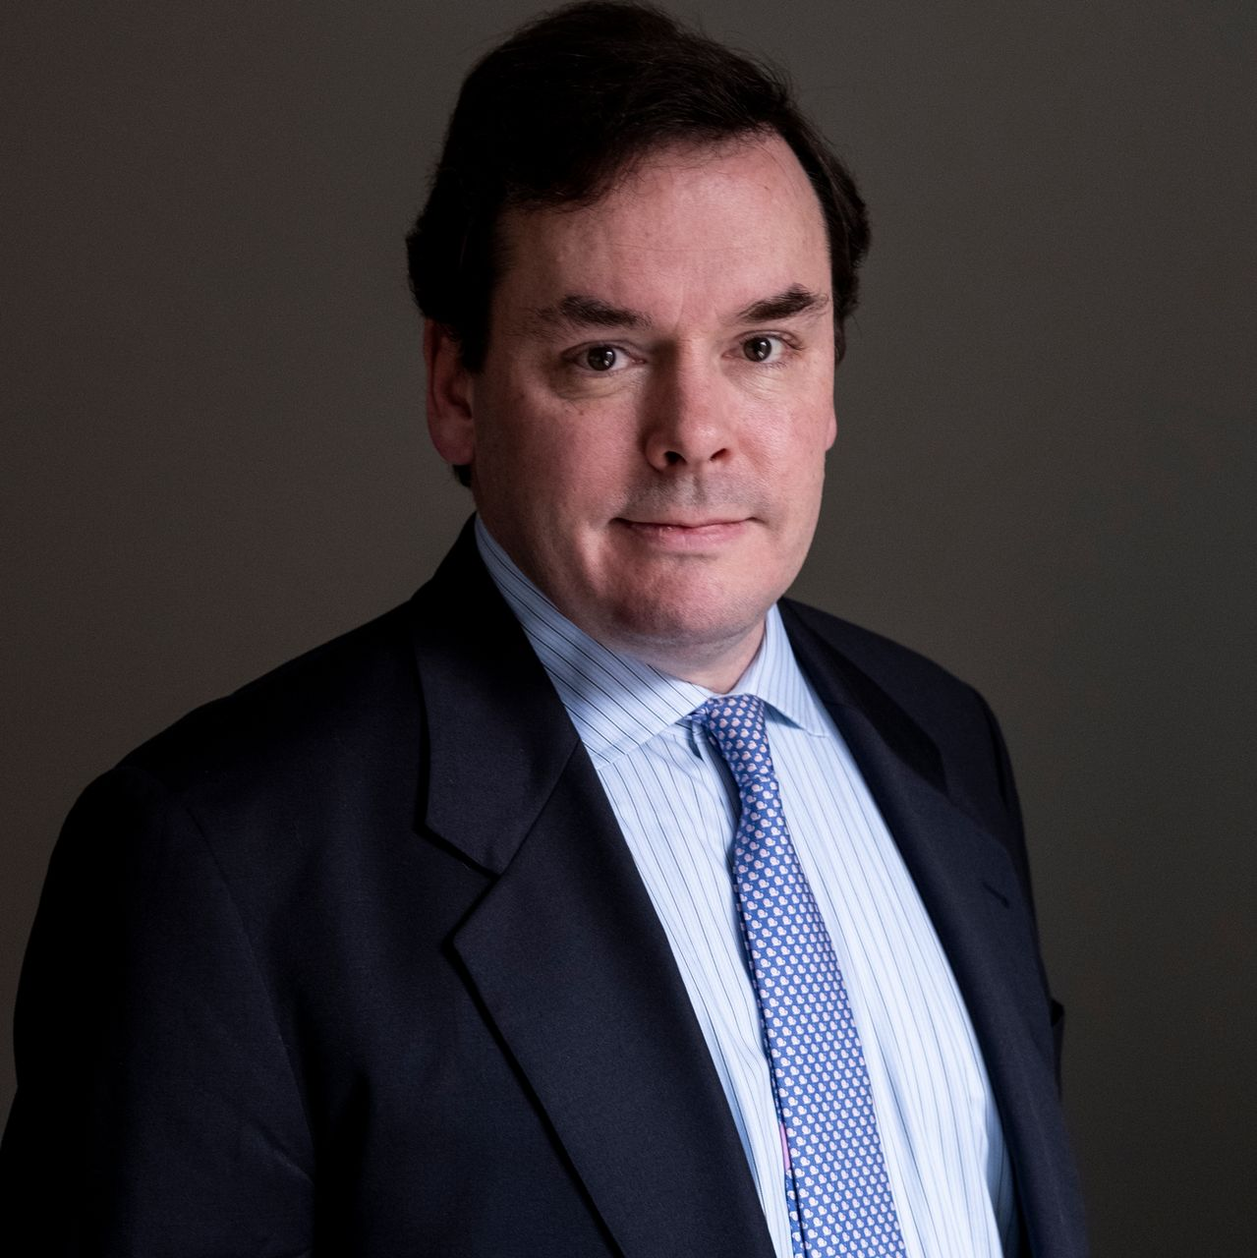
Performance of Mutual Fund Manager
Market Condition | Rank on Four-factor Alpha
Recession | 10 percentile
Boom | 50 percentile
Inflation | Rank on Four-factor Alpha
High Inflation | 20 percentile
Low Inflation | 40 percentile

Slide 6
Performance of Mutual Fund Manager
“A sailor cannot control the wind, but she can determine how to take advantage of it to get her where she wants. Good investment strategy is to stick with the approach over the long run. This discipline applies not only to staying with your positions. It also means re-entering the markets when your approach calls for it, even though uncertainties may still exist.”
Market Condition | Rank on Four-factor Alpha
Recession | 10 percentile
Boom | 50 percentile
Inflation | Rank on Four-factor Alpha
High Inflation | 20 percentile
Low Inflation | 40 percentile

Slide 7
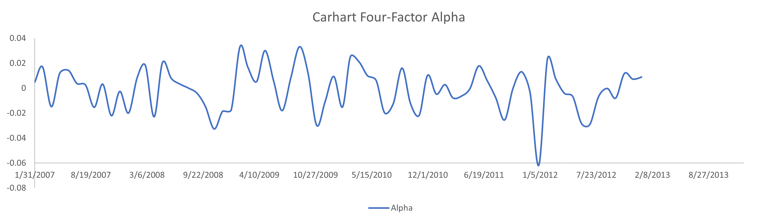
Can We Eyeball to Find Any Pattern?
?

Slide 8
Machine Can!
T-bill Yield
Market Return
Term Spread

Slide 9
Machine Can!
T-bill Yield
Market Return
Term Spread
“…over a longer period of time, there is no question that things are improving. The recession officially came to an end, driven by what has now been six consecutive quarters of growth.”
- Shareholder Letter 2011
“The Federal Reserve held benchmark interest rates to a low target range of 0% to 0.25% and pursued other initiatives designed to inject liquidity into the financial system.”
- Shareholder Letter 2010
“The Fed stated that its objective is to lower longer-term bond yields while maintaining short-term rates at their current and historically low levels.”
- Shareholder Letter 2012

Slide 10
Research Questions
Can machines identify repeated patterns in fund returns?
Would such patterns be helpful to predict future fund performance?
What is the economics behind the pattern?

Slide 11
Main Results
Yes, machine can identify the hidden and repeated patterns.
Yes, such patterns can be used to predict future return.
A long-short portfolio based on the model’s prediction generates a 2.8% annualized Carhart 4-factor alpha.
This abnormal performance is persistent for up to four years.
The prediction are associated with the macro and fundamental strategies
Fund returns are most informative when they happen after earnings announcements.
Historical performance and macroeconomic variables are the most important determinants of future fund return patterns and performance.

Slide 12
Contributions
Persistence of mutual fund performance
Performance is consistent depend on macro conditions
A new angle to evaluate mutual fund skill
Measure under static model
Return Gap (Kacperczyk, Sialm, and Zheng, 2008)
Active Share (Cremers and Petajisto, 2009)
Industry Concentration (Kacperczyk, Sialm, and Zheng, 2011)
Provide a new measure of time-varying mutual fund skill that can be measured based only on past performance, macroeconomic conditions, and fund characteristics.

Slide 13
Contributions
New Machine learning framework in financial economics
Introduce a sequence-to-sequence model that is particularly suitable for capturing dynamic time-series patterns.
Customized machine learning model to handle different types of inputs.
Explainable intermediate outputs to open the black box of machine learning model.

Slide 14
Data and Features
Data Sources: CRSP Mutual Fund, Fed St. Louis
Sample: active U.S. equity funds from 1990m1 to 2019m12
Historical Mutual Fund Performance
Carhart four-factor alpha from gross return
Macro-level features
12 features
Including Inflation, Oil Prices, Term Spread, Default Spread, VIX, etc
Fund Characteristics
Fund Style, Fund Size, Fund Flow, Turnover Ratio, Cash, Manager Fee, Expense Ratio, Load, Manager Tenure
Factors
From Fama and French five-factor model and Hou, Xue, and Zhang q-factor model

Slide 15
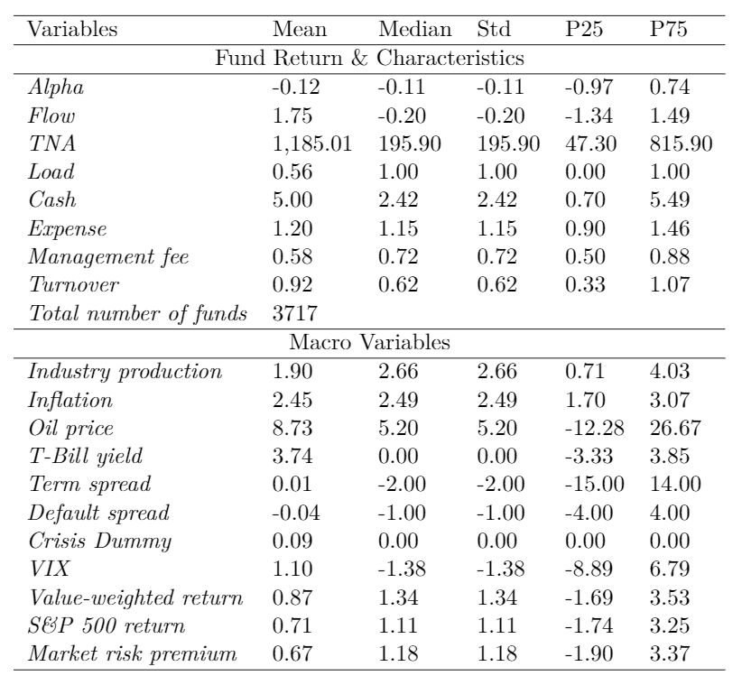
Summary Statistics

Slide 16
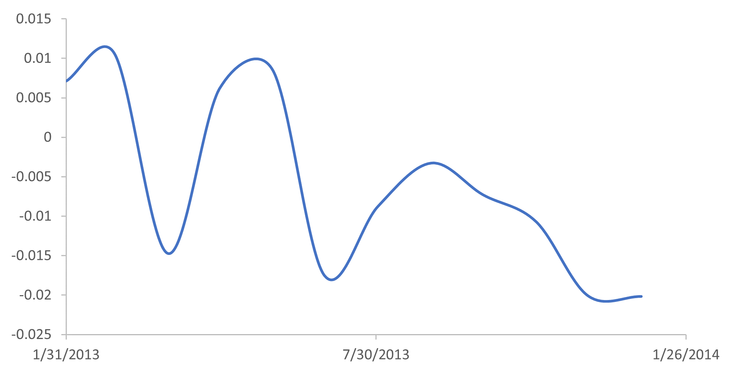
Temporal Fusion Transformers (TFT) Model
Originally used for language translation and prediction
TFT Model
Historical Alpha
Future Alpha

Slide 17
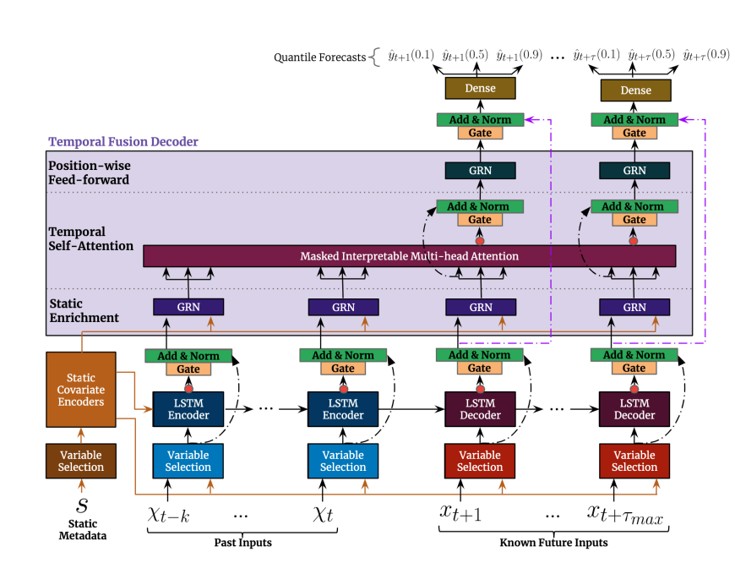
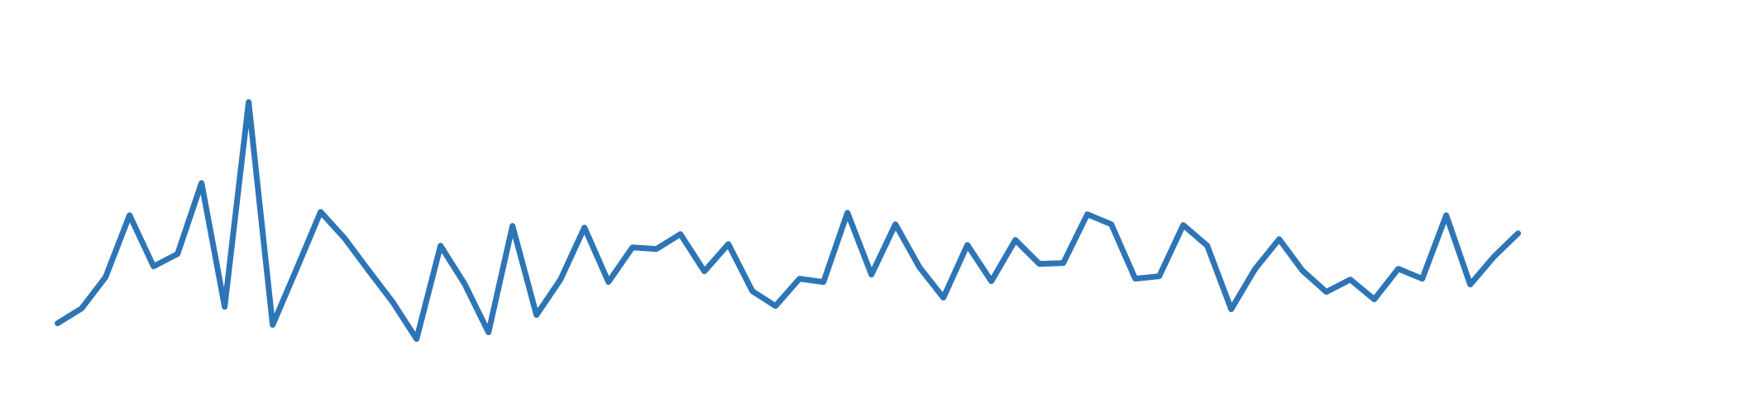
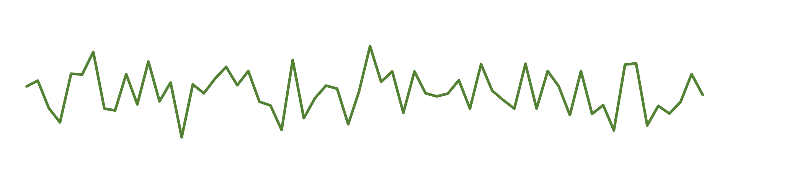
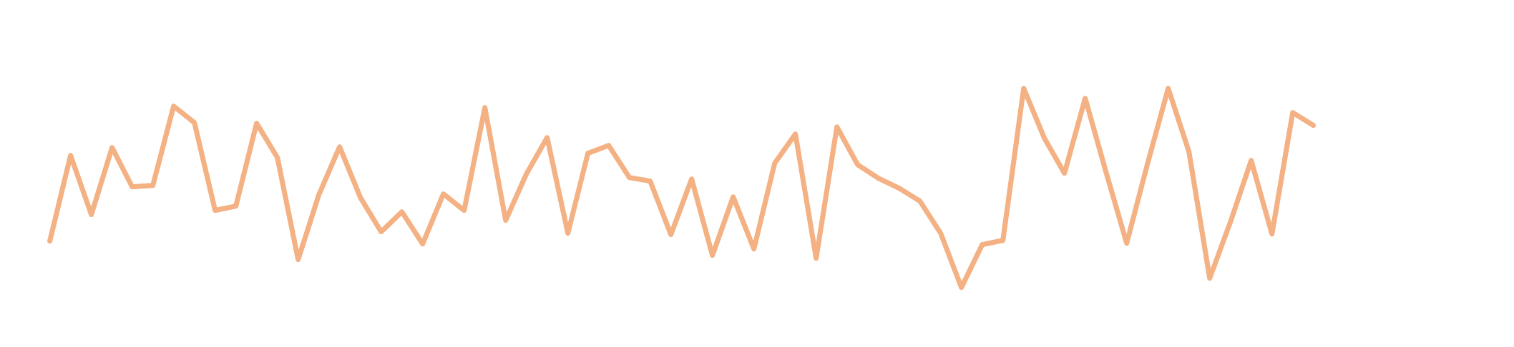



Structure of TFT Model
$×[w_{i,1}, w_{i,2},……,w_{i,t}$]
Variable Selection Module
$×[w_{j,1}, w_{j,2},……,w_{j,t}$]
$×[w_{k,1}, w_{k,2},……,w_{k,t}$]
Variable Selection

Slide 18



Structure of TFT Model
LSTM Encoder and Decoder
$$φ\left(t,n\right)∈\{φ\left(t,−k\right), ………………………………,φ\left(t,t_{max}\right)\}$$
LSTM Encoder
LSTM Decoder
$×[w_{i,1}, w_{i,2},……,w_{i,t}$]
$×[w_{j,1}, w_{j,2},……,w_{j,t}$]
$×[w_{k,1}, w_{k,2},……,w_{k,t}$]

Slide 19

Structure of TFT Model
Attention
$$φ\left(t,n\right)∈\{φ\left(t,−k\right), ………………………………,φ\left(t,t_{max}\right)\}$$

Slide 20

Structure of TFT Model
Output
Minimizing the quantile loss:

Slide 21
Predicting Mutual Fund Performance
72-month estimation horizon and 12-month prediction horizon
train ML model
tune ML model
Out-of-sample prediction
Training Samples
Validation Samples
Test Samples
1990m1
80% : 20%
2010m1
2020m1

Slide 22

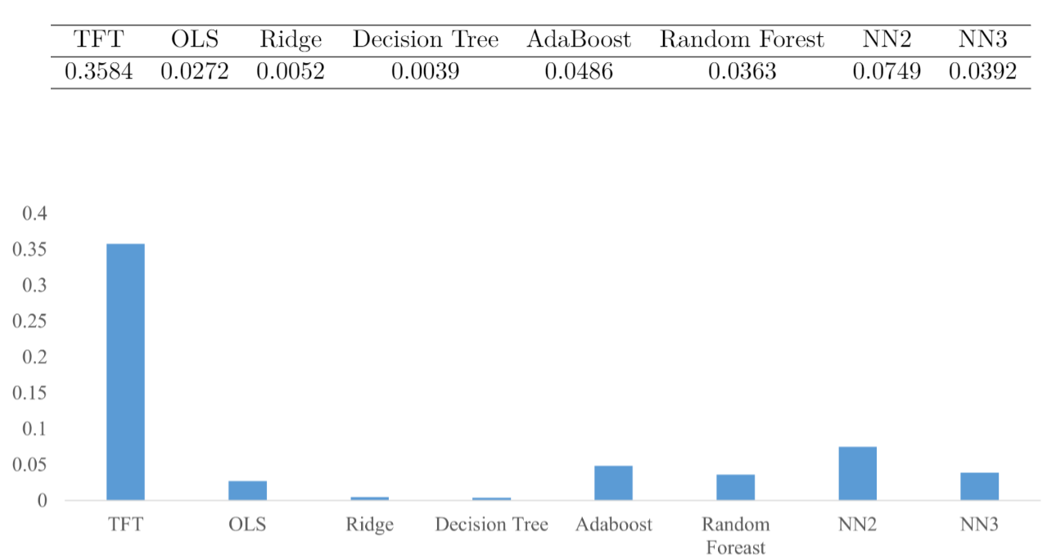
Comparison of Machine Learning Models
TFT model outperforms other benchmark models in out-of-sample $R^{2}$ following Gu, Kelly, and Xiu (2020):
Measure in percentage

Slide 23
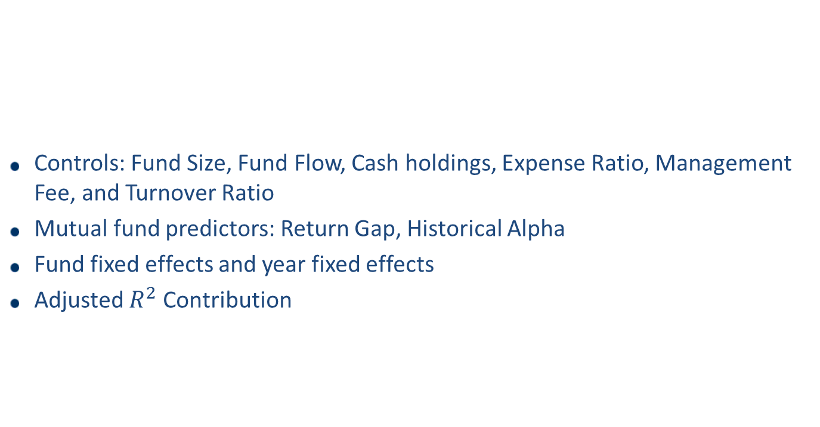
Predicting Power Analysis
Controls: Fund Size, Fund Flow, Cash holdings, Expense Ratio, Management Fee, and Turnover Ratio
Mutual fund predictors: Return Gap, Historical Alpha
Fund fixed effects and year fixed effects
Adjusted $R^{2}$ Contribution

Slide 24
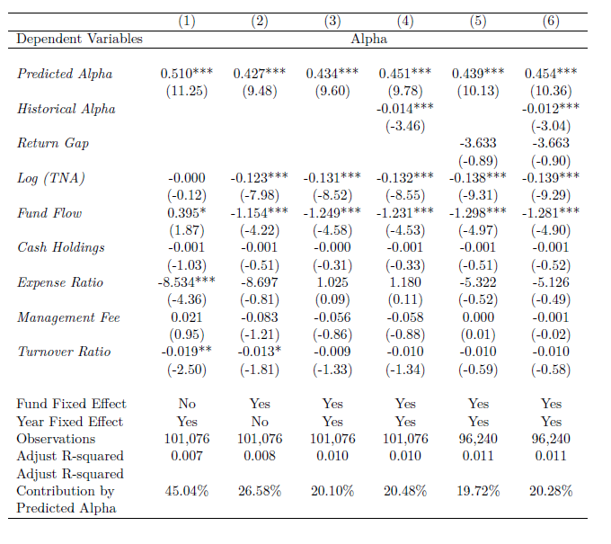
Predicting Power Analysis

Slide 25
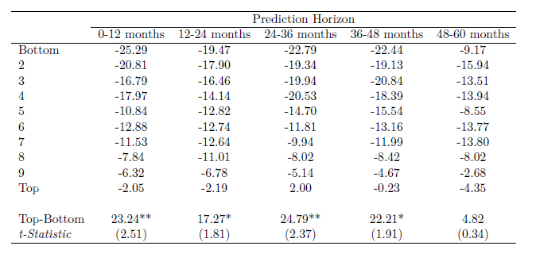
Portfolio Return and Persistence
Decile monthly rebalanced portfolio based on 12-month prediction.
Maintain the same weight construction of the first year to all future years.

Slide 26
Sources of Predicting Power
What’s the sources of predicting power?
From the cross-sectional performance differences across funds?
From a fund’s relative performance over time?
5 × 4 double-sorted portfolios
First sort cross-sectionally into quintile portfolios by the predicted average annual performance.
i.e., funds with annual performance in the top quintile are assigned to the top cross-sectional portfolio (p5)
Then sort timewise into quartile portfolios based on the relative predicted alpha of different months for the same fund.
i.e., fund’s top three performance months will be assigned to the top time-series portfolio (t4)
Sort cross-sectionally
Sort timewise
 | P1 | P2 | P3 | P4 | P5
T1 | Worst
T2
T3
T4 |  |  |  |  | Best

Slide 27
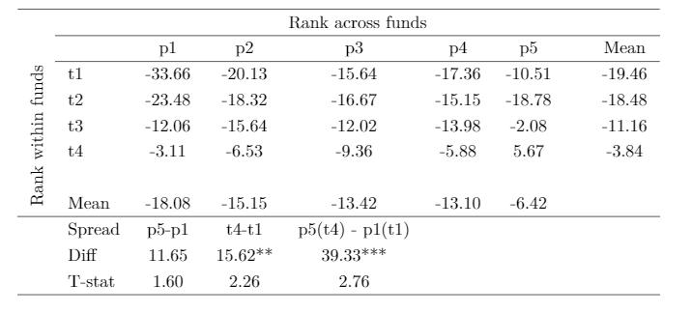
Sources of Predicting Power

Slide 28
Understanding and Interpreting the Model
Dynamic variable importance
Attention
The return patterns are associated with the macro and fundamental strategies
Fund returns are most informative when they happen after earnings announcements
Funds that are more impacted by macroeconomics variable can predict better in the model

Slide 29
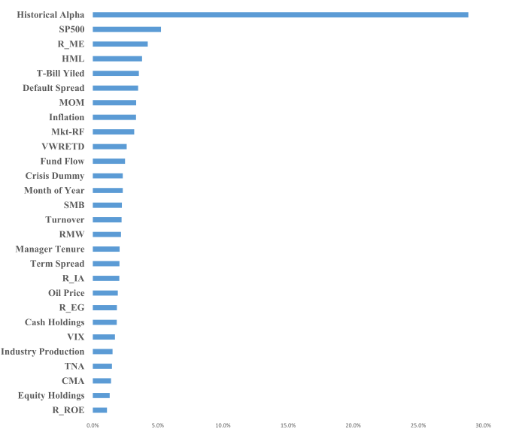
Variable Importance
Historical performance and macroeconomic variables are the most important determinants.

Slide 30
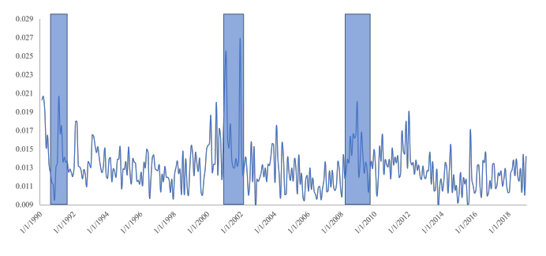
Time Series of Attention in the Model
Attention varies dramatically over time, and the months with the highest weights reside in the economic crisis periods
Macro conditions exert significant influence on the learning of return patterns

Slide 31
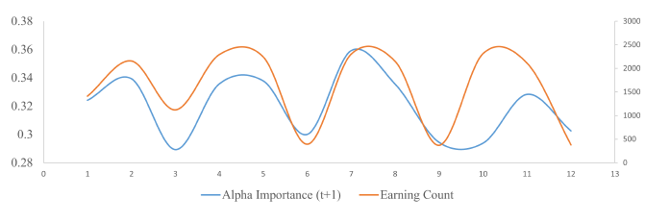
Alpha Importance and Earning Announcements
Variable importance of the historical alpha shows seasonal pattern
Number of earning announcements made by companies held by funds
Pinnuck (2005): Earnings information explains approximately 25% of a mutual fund's average monthly abnormal performance

Slide 32
Model Prediction
Alpha Importance
Variable importance of the historical alpha in the model.
Related to fundamental (bottom-up) investment strategy.
Macro Importance
Sum of the variable importance of the macroeconomics variables in the model
Related to macro (top-down) investment strategy.

Slide 33
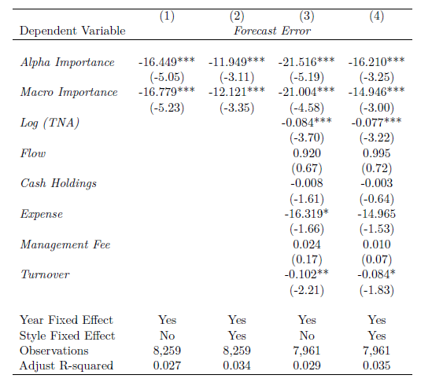
Model Prediction

Slide 34
Conditional Return Persistence
Historical performance can predict return when the macro variable importance is high

Slide 35
Conditional Return Persistence
The persistent is up to 6 month

Slide 36
Robustness Tests
Combine with holding information
High turnover when the variable importance
Fund Level, Manager Level, or Stock Level
No predictive power for 1000 hypothetical buy and hold portfolio of 100 stocks in S&P 500 index
Results are similar but weaker when we predict at the manager level

Slide 37
Conclusion
State-of-the-art deep learning model to understand and predict dynamic patterns in mutual fund returns
Model can identify hidden and repeated patterns.
The patterns can be used to persistently predict future returns.
The return patterns are associated with the macro and fundamental strategies
Fund returns are most informative when they happen after earnings announcements
Funds that are more impacted by macroeconomic variables can be better predicted in the model
A new machine learning framework in financial economics

